Slide 1

Makine Öğrenmesi
2020
Perceptron
Temel Kurallar
Ş. Sefa İşci
kave.bilgi.org.tr/
Karmaşık Sistemler ve Veri Bilimi Topluluğu
Derin Öğrenme – Yapay Sinir Ağları

Slide 2

Makine Öğrenmesi
TEMEL KURALLAR
Broadcasting
Notasyon
Perceptron
Karmaşık Sistemler ve Veri Bilimi Topluluğu
Makine Öğrenmesi - Perceptron

Slide 3
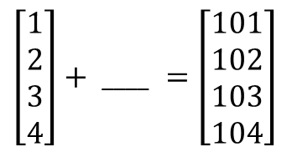

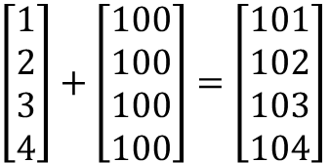

Broadcasting
$\left[\begin{aligned}1 \\ 2 \\ 3 \\ 4\end{aligned}\right]+\left[\begin{aligned}100 \\ 100 \\ 100 \\ 100\end{aligned}\right]$ $=\left[\begin{aligned}101 \\ 102 \\ 103 \\ 104\end{aligned}\right]$
$\left[\begin{aligned}1 \\ 2 \\ 3 \\ 4\end{aligned}\right]+ ____$ $=\left[\begin{aligned}101 \\ 102 \\ 103 \\ 104\end{aligned}\right]$
$$\left[\begin{matrix}1 & 2 & 3 \\ 4 & 5 & 6\end{matrix}\right]+ \left[\begin{matrix}100 & 200 & 300\end{matrix}\right]=\left[\begin{matrix}101 & 202 & 303 \\ 104 & 205 & 306\end{matrix}\right]$$
$$\left[\begin{matrix}1 & 2 & 3 \\ 4 & 5 & 6\end{matrix}\right]+ \left[ \begin{matrix}100 & 200 & 300 \\ ____ & ____ & ____\end{matrix} \right]=\left[\begin{matrix}101 & 202 & 303 \\ 104 & 205 & 306\end{matrix}\right]$$
$\left[\begin{matrix}1 & 2 & 3 \\ 4 & 5 & 6\end{matrix}\right]+$ $\left[\begin{matrix}100 \\ 200\end{matrix}\right]=\left[\begin{matrix}101 & 102 & 103 \\ 204 & 205 & 206\end{matrix}\right]$
$\left[\begin{matrix}1 & 2 & 3 \\ 4 & 5 & 6\end{matrix}\right]+$ $\left[ \begin{matrix}100 & ____ & ____ \\ 200 & ____ & ____\end{matrix} \right]=\left[\begin{matrix}101 & 102 & 103 \\ 204 & 205 & 206\end{matrix}\right]$
Karmaşık Sistemler ve Veri Bilimi Topluluğu
Makine Öğrenmesi - Perceptron

Slide 4

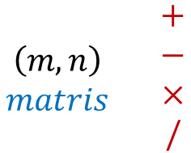

Broadcasting
$$\begin{matrix}\left(m,n\right) \\ matris\end{matrix} \begin{matrix}+ \\ − \\ × \\ /\end{matrix}$$
$$\left(1,n\right)$$
$$\left(m,1\right)$$
Karmaşık Sistemler ve Veri Bilimi Topluluğu
Makine Öğrenmesi - Perceptron

Slide 5
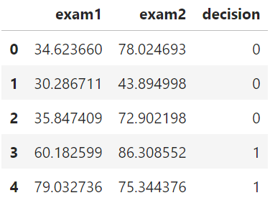

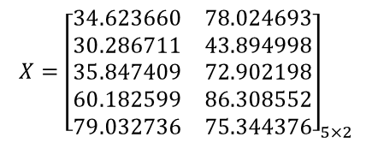
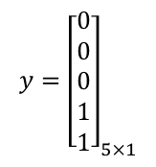
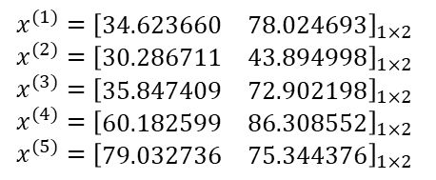
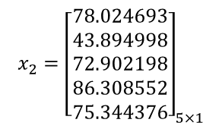
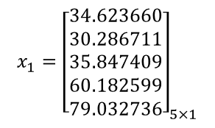
Notasyon
$$X={\left[\begin{matrix}34.623660 & 78.024693 \\ 30.286711 & 43.894998 \\ 35.847409 & 72.902198 \\ 60.182599 & 86.308552 \\ 79.032736 & 75.344376\end{matrix}\right]}_{5×2}$$
$$x_{1}={\left[\begin{aligned}&34.623660 \\ &30.286711 \\ &35.847409 \\ &60.182599 \\ &79.032736\end{aligned}\right]}_{5×1}$$
$$x_{2}={\left[\begin{aligned}&78.024693 \\ &43.894998 \\ &72.902198 \\ &86.308552 \\ &75.344376\end{aligned}\right]}_{5×1}$$
$$x^{(1)}={\left[\begin{matrix}34.623660 & 78.024693\end{matrix}\right]}_{1×2}$$
$$x^{(2)}={\left[\begin{matrix}30.286711 & 43.894998\end{matrix}\right]}_{1×2}$$
$$x^{(3)}={\left[\begin{matrix}35.847409 & 72.902198\end{matrix}\right]}_{1×2}$$
$$x^{(4)}={\left[\begin{matrix}60.182599 & 86.308552\end{matrix}\right]}_{1×2}$$
$$x^{(5)}={\left[\begin{matrix}79.032736 & 75.344376\end{matrix}\right]}_{1×2}$$
$$y={\left[\begin{aligned}&0 \\ &0 \\ &0 \\ &1 \\ &1\end{aligned}\right]}_{5×1}$$
$$w={\left[\begin{aligned}&w_{1} \\ &w_{2}\end{aligned}\right]}_{2×1}, w_{0}=b$$
Karmaşık Sistemler ve Veri Bilimi Topluluğu
Makine Öğrenmesi - Perceptron

Slide 6
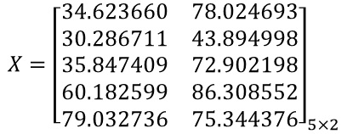


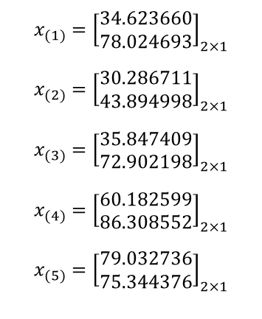

Notasyon
$$X={\left[\begin{matrix}34.623660 & 78.024693 \\ 30.286711 & 43.894998 \\ 35.847409 & 72.902198 \\ 60.182599 & 86.308552 \\ 79.032736 & 75.344376\end{matrix}\right]}_{5×2}$$
$$X^{T}=x={\left[\begin{matrix}34.623660 & 30.286711 & 35.847409 & 60.182599 & 79.032736 \\ 78.024693 & 43.894998 & 72.902198 & 86.308552 & 75.344376\end{matrix}\right]}_{2×5}$$
$$x_{(1)}={\left[\begin{aligned}34.623660 \\ 78.024693\end{aligned}\right]}_{2×1}$$
$$x_{(2)}={\left[\begin{aligned}30.286711 \\ 43.894998\end{aligned}\right]}_{2×1}$$
$$x_{(3)}={\left[\begin{aligned}35.847409 \\ 72.902198\end{aligned}\right]}_{2×1}$$
$$x_{(4)}={\left[\begin{aligned}60.182599 \\ 86.308552\end{aligned}\right]}_{2×1}$$
$$x_{(5)}={\left[\begin{aligned}79.032736 \\ 75.344376\end{aligned}\right]}_{2×1}$$
$$X^{T}=x=\left[\begin{aligned}−{ x}_{1}^{T}− \\ − x_{2}^{T}−\end{aligned}\right]$$
$$w^{T}={\left[\begin{matrix}w_{1} & w_{2}\end{matrix}\right]}_{1×2}, w_{0}=b$$
$$y={\left[\begin{matrix}0 & 0 & 0 & 1 & 1\end{matrix}\right]}_{1×5}$$
Karmaşık Sistemler ve Veri Bilimi Topluluğu
Makine Öğrenmesi - Perceptron

Slide 7














Notasyon
$$w=\left[\begin{aligned}&w_{1} \\ &w_{2}\end{aligned}\right], w_{0}=b$$
$$w=\left[\begin{aligned}w_{0} \\ w_{1} \\ w_{2}\end{aligned}\right]$$
$w=\left[\begin{aligned}&w_{1} \\ &w_{2}\end{aligned}\right],$ $w_{0}=b$
$$w=\left[\begin{aligned}w_{0} \\ w_{1} \\ w_{2}\end{aligned}\right]$$
$$X=\left[\begin{matrix}| & | \\ x_{1} & x_{2} \\ | & |\end{matrix}\right]$$
$$X=\left[\begin{matrix}| & | & | \\ x_{0} & x_{1} & x_{2} \\ | & | & |\end{matrix}\right]$$
$$X=\left[\begin{matrix}| & | \\ x_{1} & x_{2} \\ | & |\end{matrix}\right]$$
$$X=\left[\begin{matrix}| & | & | \\ x_{0} & x_{1} & x_{2} \\ | & | & |\end{matrix}\right]$$
$$x=X^{T}=\left[\begin{matrix}− x_{0}^{T}− \\ − x_{1}^{T}− \\ − x_{2}^{T}−\end{matrix}\right]$$
$$x=X^{T}=\left[\begin{aligned}&−{ x}_{1}^{T}− \\ &{− x}_{2}^{T}−\end{aligned}\right]$$
$$z=Xw+b$$
$$z=Xw$$
$$z=w^{T}x+b$$
$$z=w^{T}x$$
Karmaşık Sistemler ve Veri Bilimi Topluluğu
Makine Öğrenmesi - Perceptron

